Slide 2
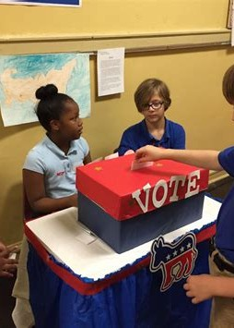
College Event Voting
The college event voting is an Android application that allows students to vote for their favorite events and choose winners.

Slide 3



Features of the Application
Easy Voting
The application has a simple and user-friendly interface that makes it effortless for anyone to vote.
Quick Results
The application gives real-time results of the votes casted and accurate reports of the events held.
Security
The application requires students to log in using their college credentials to cast votes, ensuring no outsiders or bots can manipulate the process.

Slide 4

How the Application Works
Students download and install the app
They log in using their college ID and password They search for events they want to vote for
They swipe and click on the vote button of their favorite event Results get displayed instantly

Slide 5
Benefits of the Application for College Community
1
Transparency
The college event voting application provides a transparent platform where students can vote without any external interference.
Engagement
The voting application encourages students to participate in college events
actively.
2
3
Improvement
The feedback from the voting application allows the college to improve its event planning and management.
Fun
Students can engage in friendly competition, cheering, and supporting each other during the events.
4

Slide 6
Ensuring Fair Voting
Login Authentication
The application requires students to log in using their college credentials to cast votes, ensuring no outsiders or bots can manipulate the process.
Anonymity
The application ensures student privacy by keeping the voting information anonymous and disclosing the results without displaying any personal information.
Multiple Security Layer
We have multiple technical security measures in place to prevent malpractice, data loss, or data manipulation.

Slide 7
THANK YOU

